Slide 1
Chapter 6: Project Human Resource Management
Information Technology Project Management, Sixth Edition
Note: See the text itself for full citations.

Slide 2
Learning Objectives
Explain the importance of good human resource management on projects, including the current state of the global IT workforce and future implications for it
Define project human resource management and understand its processes
Summarize key concepts for managing people by understanding the theories of Abraham Maslow, Frederick Herzberg, David McClelland, and Douglas McGregor on motivation, H. J. Thamhain and D. L. Wilemon on influencing workers, and Stephen Covey on how people and teams can become more effective

Slide 3
Learning Objectives
Discuss human resource management planning and be able to create a human resource plan, project organizational chart, responsibility assignment matrix, and resource histogram
Understand important issues involved in project staff acquisition and explain the concepts of resource assignments, resource loading, and resource leveling
Assist in team development with training, team-building activities, and reward systems
Explain and apply several tools and techniques to help manage a project team and summarize general advice on managing teams
Describe how project management software can assist in project human resource management

Slide 4
The Importance of Human Resource Management
Many corporate executives have said, “People are our most important asset”
People determine the success and failure of organizations and projects
Project human resource management is a vital component of project management

Slide 5
The Global IT Workforce
Although there have been ups and downs in the IT labor market, there will always be a need for good IT workers
The Digital Planet 2010 study predicts that ICT spending will have an annual growth rate of more than 6 percent each year through 2013, when it will reach almost $5 trillion
Thirty-three percent of the world’s population is online, and 45 percent of Internet users are below the age of 25

Slide 6
Implications for the Future of IT Human Resource Management
Proactive organizations are addressing workforce needs by
improving benefits
redefining work hours and incentives
finding future workers
As Ethiopia continues to develop its IT sector, it will be important for companies to prioritize human resource management.

Slide 7
Cont’d
This includes recruiting and retaining top talent, providing opportunities for professional development and training, and creating a positive and supportive work environment.
Additionally, with the increasing use of automation and artificial intelligence, companies must also consider the implications for their workforce and how to best prepare and reskill employees for the changing technological landscape.
Overall, effective human resource management will be critical for the success of Ethiopia's IT industry in the future.

Slide 8
What is Project Human Resource Management?
Making the most effective use of the people involved with a project
Processes include
Planning human resource management: identifying and documenting project roles, responsibilities, and reporting relationships
Acquiring the project team: getting the needed personnel assigned to and working on the project
Developing the project team: building individual and group skills to enhance project performance
Managing the project team: tracking team member performance, motivating team members, providing timely feedback, resolving issues and conflicts, and coordinating changes to help enhance project performance
Notes:
Project Human Resource Management refers to the processes and activities involved in managing the human resources of a project. It includes planning, acquiring, developing, and managing the project team to ensure that they have the necessary skills, knowledge, and experience to successfully complete the project. The main objective of Project Human Resource Management is to optimize the use of the project team's skills and abilities, and ensure that they are motivated, committed, and working efficiently towards the project's goals. This process also involves managing team dynamics, resolving conflicts, and ensuring that the project team is aligned with the overall project plan and objectives.
Regenerate

Slide 9
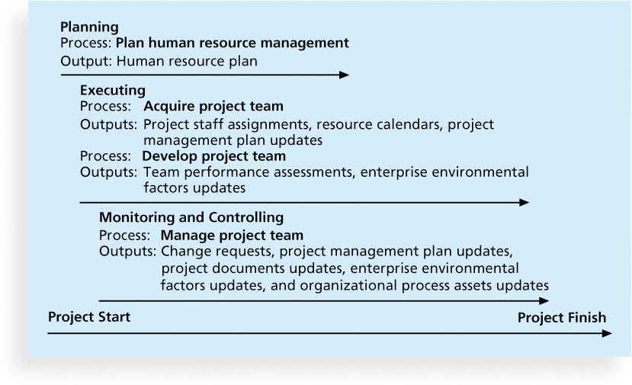
Figure 9-1. Project Human Resource Management Summary

Slide 10
Keys to Managing People
Psychologists and management theorists have devoted much research and thought to the field of managing people at work
Important areas related to project management include
motivation theories
influence and power
effectiveness

Slide 11
Intrinsic and Extrinsic Motivation
Intrinsic motivation causes people to participate in an activity for their own enjoyment
Extrinsic motivation causes people to do something for a reward or to avoid a penalty
For example, some children take piano lessons for intrinsic motivation (they enjoy it) while others take them for extrinsic motivation (to get a reward or avoid punishment)
Notes:
Intrinsic motivation refers to engaging in an activity because of the inherent satisfaction and enjoyment that comes from the activity itself. For example, a person may enjoy playing a musical instrument simply because they find it fun and rewarding.
Extrinsic motivation, on the other hand, refers to engaging in an activity because of external rewards or pressures. For example, a person may work hard at their job because they are motivated by the promise of a bonus or promotion.

Slide 12
Maslow’s Hierarchy of Needs
Abraham Maslow argued that humans possess unique qualities that enable them to make independent choices, thus giving them control of their destiny
Maslow developed a hierarchy of needs which states that people’s behaviors are guided or motivated by a sequence of needs

Slide 13
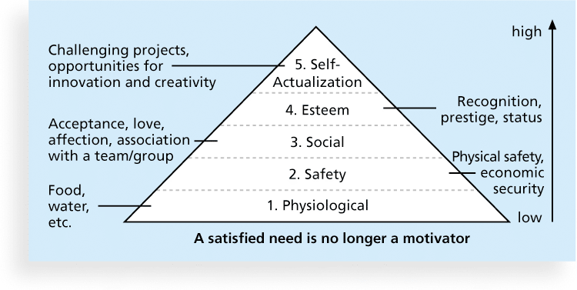
Figure 9-2. Maslow’s Hierarchy of Needs
Notes:
There are several motivation theories that explain why people behave the way they do in different situations. One of the most well-known theories is Maslow's hierarchy of needs, which suggests that people have five basic needs that must be met in order to be motivated: physiological, safety, love/belonging, esteem, and self-actualization. Another popular theory is Herzberg's two-factor theory, which proposes that there are two types of factors that influence motivation: hygiene factors (such as salary, working conditions, and job security) and motivators (such as recognition, achievement, and growth opportunities). Additionally, there are other motivation theories such as Expectancy Theory, Equity Theory, and Self-Determination Theory which also provide insights into what drives human motivation.

Slide 14
Herzberg’s Motivational and Hygiene Factors
Frederick Herzberg wrote several famous books and articles about worker motivation. He distinguished between
motivational factors: achievement, recognition, the work itself, responsibility, advancement, and growth, which produce job satisfaction
hygiene factors: cause dissatisfaction if not present, but do not motivate workers to do more. Examples include larger salaries, more supervision, and a more attractive work environment
Notes:
Herzberg's Motivational and Hygiene Factors is a theory of workplace motivation developed by psychologist Frederick Herzberg in the 1950s. The theory suggests that there are two categories of factors that influence employee motivation and job satisfaction:

Slide 15
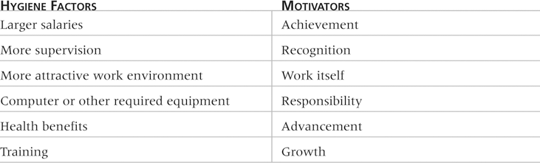
Table 9-1: Examples of Herzberg’s Hygiene Factors and Motivators

Slide 16
McClelland’s Acquired-Needs Theory
Specific needs are acquired or learned over time and shaped by life experiences, including:
Achievement (nAch): Achievers like challenging projects with achievable goals and lots of feedback
Affiliation (nAff): People with high nAff desire harmonious relationships and need to feel accepted by others, so managers should try to create a cooperative work environment for them
Power: (nPow): People with a need for power desire either personal power (not good) or institutional power (good for the organization). Provide institutional power seekers with management opportunities

Slide 17
McGregor’s Theory X and Y
Douglas McGregor popularized the human relations approach to management in the 1960s
Theory X: assumes workers dislike and avoid work, so managers must use coercion, threats and various control schemes to get workers to meet objectives
Theory Y: assumes individuals consider work as natural as play or rest and enjoy the satisfaction of esteem and self-actualization needs
Theory Z: introduced in 1981 by William Ouchi and is based on the Japanese approach to motivating workers, emphasizing trust, quality, collective decision making, and cultural values
Notes:
McGregor's Theory X and Theory Y are two contrasting approaches to management that describe different assumptions about human nature and motivation.
Theory X assumes that people are inherently lazy, dislike work, and need to be coerced or threatened with punishment in order to perform well. Therefore, managers who subscribe to Theory X believe that they need to exercise tight control over their employees, micromanage their work, and use rewards and punishments to motivate them.
Theory Y, on the other hand, assumes that people are inherently motivated to work and enjoy using their creativity and problem-solving skills to accomplish tasks. Managers who subscribe to Theory Y believe that they should empower their employees, give them autonomy and responsibility, and provide them with opportunities for personal and professional growth.
McGregor argued that managers who adopt Theory Y are more likely to create a positive work environment that fosters innovation, teamwork, and job satisfaction, while managers who adopt Theory X are more likely to create a negative work environment that fosters resentment, low morale, and turnover.

Slide 18
Thamhain and Wilemon’s Ways to Have Influence on Projects
1. Authority: the legitimate hierarchical right to issue orders
2. Assignment: the project manager's perceived ability to influence a worker's later work assignments
3. Budget: the project manager's perceived ability to authorize others' use of discretionary funds
4. Promotion: the ability to improve a worker's position
5. Money: the ability to increase a worker's pay and benefits

Slide 19
Thamhain and Wilemon’s Ways to Have Influence on Projects (cont’d)
6. Penalty: the project manager's ability to cause punishment
7. Work challenge: the ability to assign work that capitalizes on a worker's enjoyment of doing a particular task
8. Expertise: the project manager's perceived special knowledge that others deem important
9. Friendship: the ability to establish friendly personal relationships between the project manager and others
Notes:
Thamhain and Wilemon's Influence and Power theory proposes that power and influence are two key factors that affect the behavior of individuals and groups within an organization.
Power refers to the ability to control or influence the behavior of others, either through formal authority (such as a manager's position) or through informal means (such as expertise or personal relationships). According to Thamhain and Wilemon, power can be used in either a positive or negative way, depending on the intentions of the person wielding it.
Influence, on the other hand, refers to the ability to persuade or change the attitudes and behaviors of others without using formal authority. Influence can be based on factors such as expertise, charisma, or social status.
Thamhain and Wilemon argue that both power and influence are important for effective leadership and that effective leaders need to be able to balance the use of both. They suggest that leaders should use their power in a positive way to create a supportive work environment and motivate their employees, while also using their influence to build relationships and gain the cooperation of others.

Slide 20
Ways to Influence that Help and Hurt Projects
Projects are more likely to succeed when project managers influence with
expertise
work challenge
Projects are more likely to fail when project managers rely too heavily on
authority
money
penalty

Slide 21
Power
Power is the potential ability to influence behavior to get people to do things they would not otherwise do
There are five main types of power, based on French and Raven s classic study, "The Bases of Social Power“.

Slide 22
Power(cont’d)
Coercive power: This type of power involves the use of threats or punishment to influence others.
Reward power: This type of power involves the ability to offer rewards or incentives to influence others.
Legitimate power: This type of power is based on an individual's formal position or authority within an organization or society.
Expert power: This type of power is based on an individual's knowledge, skills, and expertise in a particular area.
Referent power: This type of power is based on an individual's personal characteristics, such as charisma, charm, and likability, that make them attractive to others

Slide 23
Covey and Improving Effectiveness
Project managers can apply Covey’s 7 habits to improve effectiveness on projects
Be proactive
Begin with the end in mind
Put first things first
Think win/win
Seek first to understand, then to be understood
Synergize: is the concept that the whole is equal to more than the sum of its parts.
Sharpen the saw: to develop and renew their physical, spiritual, mental, and social/emotional selves.

Slide 24
Empathic Listening and Rapport
Good project managers are empathic listeners - they listen with the intent to understand
Before you can communicate with others, you have to have rapport – a relation of harmony, conformity, accord, or affinity
Mirroring is the matching of certain behaviors of the other person, a technique to help establish rapport
IT professionals need to develop empathic listening and other people skills to improve relationships with users and other stakeholders
Notes:
Empathic listening and rapport are both important communication skills that can enhance relationships and understanding in various settings, including personal and professional interactions.
Empathic listening involves actively listening to someone with the intent of understanding their perspective and feelings. It requires setting aside one's own biases and actively engaging with the speaker to gain insight into their thoughts and emotions. Empathic listening can help build trust, respect, and understanding between individuals.
Rapport, on the other hand, refers to a harmonious relationship between people or groups. It is often built through positive communication, mutual respect, and shared experiences. Building rapport can help establish a connection and foster a sense of trust, which can lead to more effective communication and collaboration.
In summary, empathic listening and rapport are both important skills for building positive relationships and effective communication. Empathic listening helps individuals understand and connect with others on a deeper level, while rapport helps establish a sense of trust and mutual respect.
Yes, mirroring is a technique that can be used to establish rapport and build connections with others. Mirroring involves subtly imitating the body language, tone of voice, and speech patterns of the person you are communicating with. This technique can help create a sense of familiarity and similarity, which can help establish trust and rapport.
For example, if the person you are speaking with is sitting with their arms crossed, you might cross your arms as well. If they are speaking in a slow and deliberate manner, you might also speak in a similar way. It is important to note that mirroring should be done subtly and naturally, as overt or forced mirroring can come across as insincere or manipulative.
Overall, mirroring is one technique that can be used to establish rapport and build connections with others, but it should be used in conjunction with other communication skills and strategies to foster positive relationships.

Slide 25
Developing the Human Resource Plan
Involves identifying and documenting project roles, responsibilities, skills, and reporting relationships.
Contents include
project organizational charts
staffing management plan
responsibility assignment matrixes
resource histograms

Slide 26
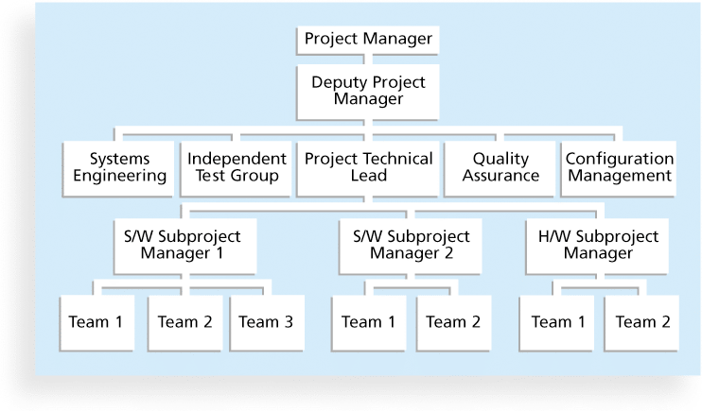
Figure 9-3. Sample Organizational Chart for a Large IT Project

Slide 27
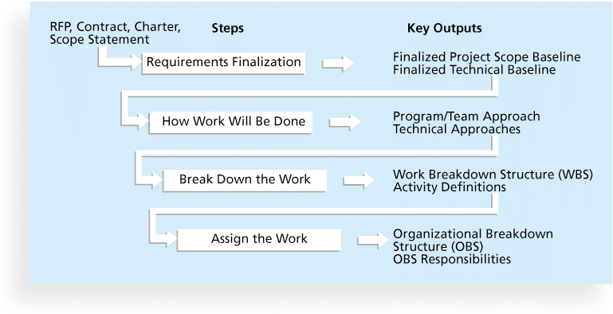
Figure 9-4. Work Definition and Assignment Process

Slide 28
Responsibility Assignment Matrices
A responsibility assignment matrix (RAM) is a matrix that maps the work of the project as described in the WBS to the people responsible for performing the work as described in the organizational breakdown structure (OBS)
Can be created in different ways to meet unique project needs
Notes:
An organizational breakdown structure (OBS) is a specific type of organizational chart that shows which organizational units are responsible for which work items. The OBS can be based on a general organizational chart and then broken down into more detail, based on specific units within departments in the company or units in any subcontracted companies. For example, OBS categories might include software development, hardware development, training, and so on.

Slide 29
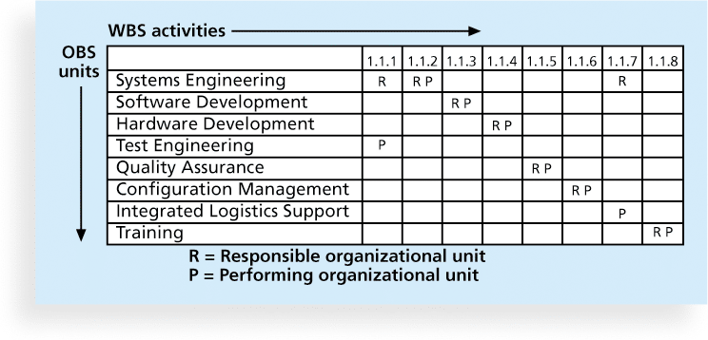
Figure 9-5. Sample Responsibility Assignment Matrix (RAM)

Slide 30
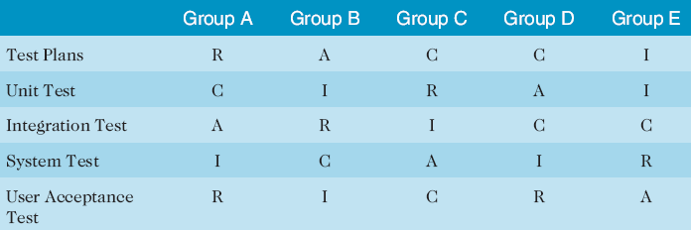
Table 9-2. Sample RACI Chart
R = responsibility
A = accountability, only one A per task
C = consultation
I = informed
Note that some people reverse the definitions of responsible and accountable.
Notes:
RACI is a project management tool that stands for Responsible, Accountable, Consulted, and Informed. It is used to clarify roles and responsibilities within a project team, ensuring that everyone knows what is expected of them and who should be involved in decision-making processes.

Slide 31
Staffing Management Plans and Resource Histograms
A staffing management plan describes when and how people will be added to and taken off the project team
A resource histogram is a column chart that shows the number of resources assigned to a project over time.
Figure 9-7 provides an example of a histogram that might be used for a six-month information technology project.
Notes:
Staffing Management Plans and Resource Histograms are two important tools used in project management. The Staffing Management Plan outlines how the project team will be staffed, including the roles and responsibilities of each team member and the timeline for hiring and training. Resource Histograms, on the other hand, are graphical representations of the project's resource utilization over time, allowing managers to see how resources (such as staff, equipment, and materials) are being allocated throughout the project.
In Ethiopia, these tools can be particularly helpful in managing large-scale infrastructure projects, such as roads, bridges, and buildings. By developing a comprehensive Staffing Management Plan, project managers can ensure that they have the right people with the right skills in place to complete the project on time and within budget. Resource Histograms can also help managers to identify potential resource constraints and adjust their plans accordingly, which can help to avoid delays and cost overruns. Overall, the use of these tools can contribute to the successful completion of projects that are vital to Ethiopia's economic growth and development.

Slide 32
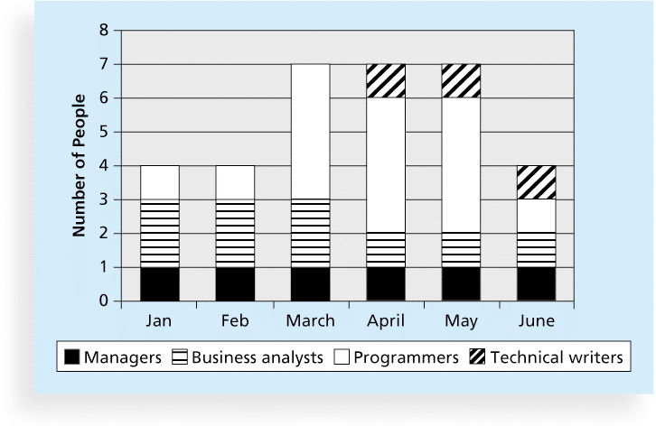
Figure 9-7. Sample Resource Histogram

Slide 33
Acquiring the Project Team
Acquiring qualified people for teams is crucial
The project manager who is the smartest person on the team has done a poor job of recruiting!
It’s important to assign the appropriate type and number of people to work on projects at the appropriate times

Slide 34
Resource Assignment
Staffing plans and good hiring procedures are important, as are incentives for recruiting and retention
Some companies give their employees one dollar for every hour a new person they helped hire works
Some organizations allow people to work from home as an incentive
Enrollment in U.S. computer science and engineering programs has dropped almost in half since 2000, and one-third of U.S. workers were over the age of 50 by 2010
CIO’s researchers suggest that organizations rethink hiring practices and incentives to hire and retain IT talent

Slide 35
Resource Loading
Resource loading refers to the amount of individual resources an existing schedule requires during specific time periods
Helps project managers develop a general understanding of the demands a project will make on the organization’s resources and individual people’s schedules
Overallocation means more resources than are available are assigned to perform work at a given time

Slide 36
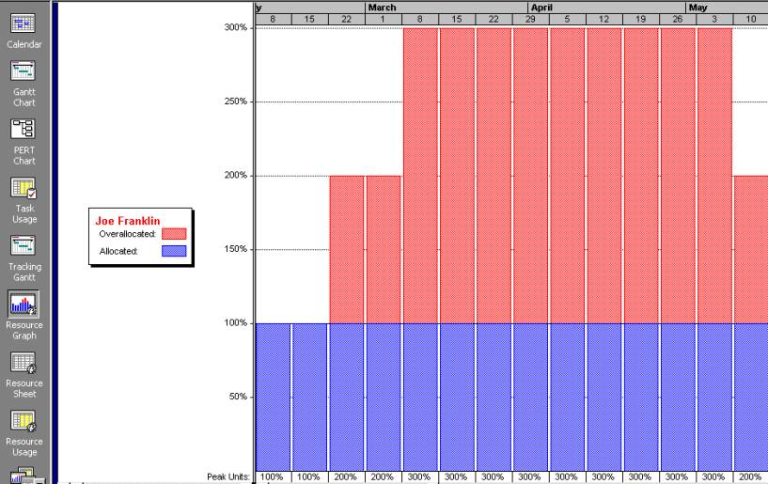
Figure 9-7. Sample Histogram Showing an Overallocated Individual

Slide 37
Resource Leveling
Resource leveling is a technique for resolving resource conflicts by delaying tasks
The main purpose of resource leveling is to create a smoother distribution of resource usage and reduce overallocation

Slide 38
Benefits of Resource Leveling
Improved project schedule
Reduced project costs
Increased productivity
Improved project quality: By avoiding overloading, resource leveling can help maintain the quality of project deliverables and reduce the risk of errors or rework.
Better project control
Overall, resource leveling is a valuable technique for ensuring the success of projects by optimizing resource utilization and balancing the workload of resources.

Slide 39
Developing the Project Team
The main goal of team development is to help people work together more effectively to improve project performance
It takes teamwork to successfully complete most projects

Slide 40
Tuckman Model of Team Development
Forming: involves the introduction of team members, either at the initiation of the team, or as new members are introduced. This stage is necessary, but little work is actually achieved.
Storming: occurs as team members have different opinions as to how the team should operate.
Norming: is achieved when team members have developed a common working method, and cooperation and collaboration replace the conflict and mistrust of the previous phase
Performing: occurs when the emphasis is on reaching the team goals, rather than working on team process.
Adjourning: involves the break-up of the team after they successfully reach their goals and complete the work
Notes:
The Tuckman Model of Team Development is a widely recognized framework for understanding the stages of team development. The model was developed by psychologist Bruce Tuckman in 1965 and has since been widely used in project management and organizational behavior. The Tuckman Model consists of four stages:
Forming: This is the initial stage of team development where team members are introduced to each other and begin to establish their roles and responsibilities. This is a time of uncertainty and exploration where team members try to establish a sense of belonging and understanding of the project's goals and objectives.
Storming: This is the stage where conflicts and disagreements may arise as team members establish their roles and responsibilities. This stage can be challenging for teams, but it is also a time of growth and development as team members learn to work together and resolve differences.
Norming: This is the stage where team members begin to establish trust and cohesion. They develop shared values and norms and begin to work together more effectively. This stage is characterized by a sense of unity and collaboration.
Performing: This is the final stage where the team is fully functional and performing at a high level. Team members are committed to the project's goals and objectives, and they work together seamlessly to achieve them.
Overall, the Tuckman Model of Team Development provides a useful framework for understanding the stages of team development and can help project managers anticipate and address challenges that may arise during the project.
👤
Adjourning
Ɛའ
Thank you for bringing up the adjourning stage. The Tuckman Model of Team Development has been updated to include a fifth stage known as adjourning or mourning. This stage is not always considered as part of the original Tuckman model, as it was added later by Tuckman and other researchers to reflect the importance of acknowledging the end of a project or the disbandment of a team.
The adjourning stage involves recognizing and celebrating the achievements of the team, mourning the end of the project or team, and transitioning team members to their next assignments or projects. This stage is important for helping team members to reflect on their experiences, learn from their successes and failures, and prepare for future projects.
During the adjourning stage, project managers may organize team-building activities, provide opportunities for feedback and reflection, and facilitate the transfer of knowledge and skills to other projects or teams. By acknowledging the end of the project or team and providing closure, the adjourning stage can help team members feel a sense of accomplishment and pride in their work, and help them transition smoothly to their next assignment or project.

Slide 41
Training
Training can help people understand themselves, each other, and how to work better in teams
Team building activities include
physical challenges
psychological preference indicator tools

Slide 42
Cont’d
There is an extensive body of literature on team development.
This section will highlight a few important tools and techniques for team development, including training, team-building activities, and reward and recognition systems

Slide 43
Meyers-Briggs Type Indicator (MBTI)
MBTI is a popular tool for determining personality preferences and helping teammates understand each other
Four dimensions include:
Extrovert/Introvert (E/I)
Sensation/Intuition (S/N)
Thinking/Feeling (T/F)
Judgment/Perception (J/P)
NTs or rationals are attracted to technology fields
IT people vary most from the general population in not being extroverted or sensing
Notes:
Extroverts are typically outgoing and draw their energy from social interactions. They tend to be talkative, assertive, and enjoy being around people. They are often comfortable in group settings, and they tend to be more expressive and outwardly emotional.
Introverts, on the other hand, tend to be quieter and more reserved. They draw their energy from their inner thoughts and ideas and may find social interactions draining. They are often more reflective, introspective, and observant, and they tend to be more comfortable in one-on-one or small group settings.
Sensation refers to the way in which an individual processes information through their five senses - sight, sound, touch, taste, and smell. Those who score high in Sensation tend to be more detail-oriented, practical, and focused on the present moment.
Intuition, on the other hand, refers to the way in which an individual processes information through patterns, impressions, and possibilities. Those who score high in Intuition tend to be more imaginative, future-oriented, and interested in abstract ideas and concepts.

Slide 44
Social Styles Profile
The Social Styles Profile assesses an individual's behavior along two dimensions: assertiveness and responsiveness.
Assertiveness refers to the degree to which an individual is comfortable expressing their opinions and taking charge in social situations. Responsiveness refers to the degree to which an individual is attuned to the needs and feelings of others, and is able to adapt their behavior accordingly.

Slide 45
Social Styles Profile(cont’d)
People are perceived as behaving primarily in one of four zones, based on their assertiveness and responsiveness:
Drivers are typically assertive/proactive and task-focused, and are comfortable taking charge in social situations.
They are firmly rooted in the present, and they strive for action
Expressives are assertive/proactive and people-focused, and are comfortable expressing their emotions and building relationships. They are future-oriented

Slide 46
Social Styles Profile(cont’d)
Amiables are responsive/reactive and people-focused, and are skilled at building and maintaining relationships.
Their time orientation varies depending on whom they are with at the time, and they strongly value relationships.
Analyticals are responsive/reactive and task-focused, and are skilled at analyzing information and problem-solving.
They are past-oriented and strong thinkers

Slide 47
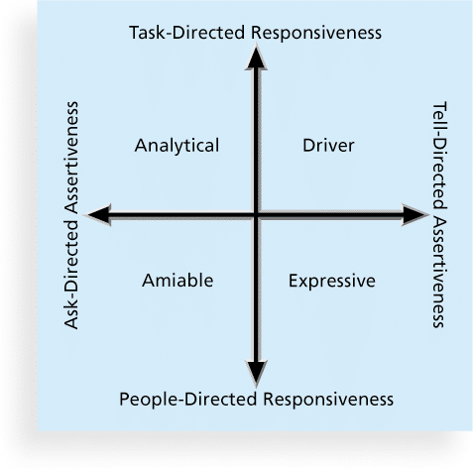
Figure 9-9. Social Styles

Slide 48
DISC Profiles
Similar to the Social Styles Profile, the DISC Profile uses a four-dimensional model of normal behavior.
Dominance
Influence
Steadiness
Compliance
People in opposite quadrants can have problems understanding each other
Notes:
DISC profiles are a popular tool used for personality assessment and development. It stands for Dominance, Influence, Steadiness, and Conscientiousness. This tool helps individuals understand their behavioral tendencies and communication styles, as well as those of others. It can be particularly useful in a team setting to improve communication and collaboration.

Slide 49
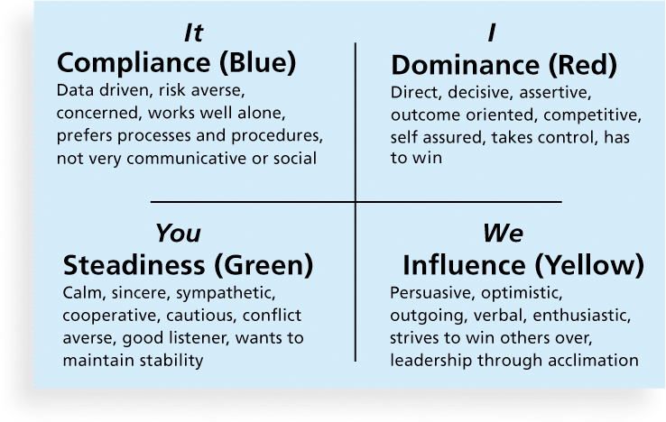
Figure 9-10. The DISC Profile

Slide 50
Reward and Recognition Systems
Another important tool for promoting team development is the use of team-based reward and recognition systems.
Team-based reward and recognition systems can promote teamwork
Focus on rewarding teams for achieving specific goals
Allow time for team members to mentor and help each other to meet project goals and develop human resources

Slide 51
Managing the Project Team
Project managers must lead their teams in performing various project activities
After assessing team performance and related information, the project manager must decide
if changes should be requested to the project
if corrective or preventive actions should be recommended
if updates are needed to the project management plan or organizational process assets.

Slide 52
Tools and Techniques for Managing Project Teams
Observation and conversation
Project performance appraisals
Interpersonal skills
Conflict management

Slide 53
Conflict Handling Modes
Confrontation: Directly face a conflict using a problem-solving approach
Compromise: Use a give-and-take approach
Smoothing: De-emphasize areas of difference and emphasize areas of agreement
Forcing: The win-lose approach
Withdrawal: Retreat or withdraw from an actual or potential disagreement
Collaborating: Decision makers incorporate different viewpoints and insights to develop consensus and commitment

Slide 54
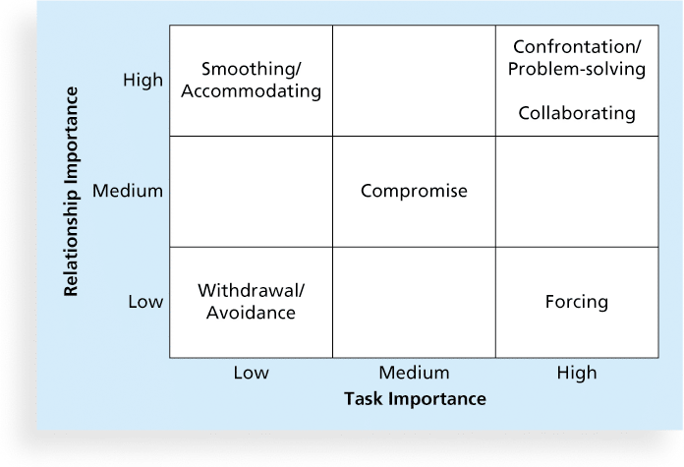
Figure 9-11. Conflict Handling Modes

Slide 55
Conflict Can Be Good
Conflict often produces important results, such as new ideas, better alternatives, and motivation to work harder and more collaboratively
Groupthink: Conformance to the values or ethical standards of a group. Groupthink can develop if there are no conflicting viewpoints
Research suggests that task-related conflict often improves team performance, but emotional conflict often depresses team performance

Slide 56
Five Dysfunctions of a Team
Patrick Lencioni, author of several books on teams, says that “Teamwork remains the one sustainable competitive advantage that has been large untapped”*
The five dysfunctions of teams are
Absence of trust
Fear of conflict
Lack of commitment
Avoidance of accountability
Inattention to results
*Lencioni, Patrick, “Overcoming the Five Dysfunctions of a Team,” Jossey-Bass: San Francisco, CA (2005), p. 3.

Slide 57
General Advice on Teams
Be patient and kind with your team
Fix the problem instead of blaming people
Establish regular, effective meetings
Allow time for teams to go through the basic team-building stages
Limit the size of work teams to three to seven members

Slide 58
General Advice on Teams (cont’d)
Plan some social activities to help project team members and other stakeholders get to know each other better
Stress team identity
Nurture team members and encourage them to help each other
Take additional actions to work with virtual team members

Slide 59
Using Software to Assist in Human Resource Management
Software can help in producing RAMS and resource histograms
Project management software includes several features related to human resource management such as
Assigning resources
Identifying potential resource shortages or underutilization
Leveling resources

Slide 60
Project Resource Management Involves Much More Than Using Software
Project managers must
Treat people with consideration and respect
Understand what motivates them
Communicate carefully with them
Focus on your goal of enabling project team members to deliver their best work

Slide 61
Chapter Summary
Project human resource management includes the processes required to make the most effective use of the people involved with a project
Main processes include
Plan human resource management
Acquire project team
Develop project team
Manage project team

Slide 62
End of Chapter-6

